Slide 1

ITS Engineer Internship with Snohomish County PUD
By: Kayla Bachler
Mentor: Ryan Huffman, Infrastructure Systems Analyst
Advisor: Rob Nash, SENIOR LECTURER in css

Slide 2


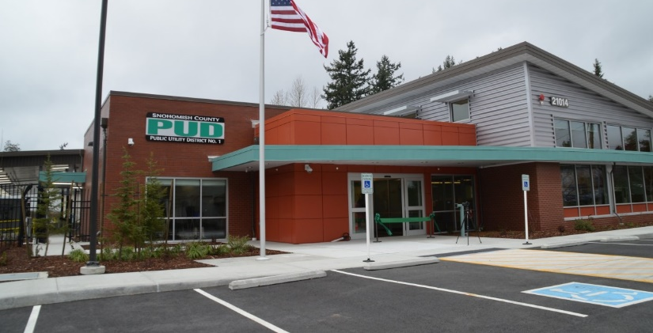

Notes:
I worked at the headquarters in downtown Everett during my internship

Slide 3
My Role
I worked with the Information Technology Services (ITS) Infrastructure Support Team to help maintain hardware and software associated with PUD’s computers
Daily Tasks
Software Install/Uninstall Scripts
Package Deployment through System Center Configuration Manager (SCCM)
Windows 10 Legacy Application Testing
Technical Documentation for Maintainability
Long-term Tasks
Replacement of 200+ District PCs
BIOS Update Script for Meltdown & Spectre Prevention

Slide 4
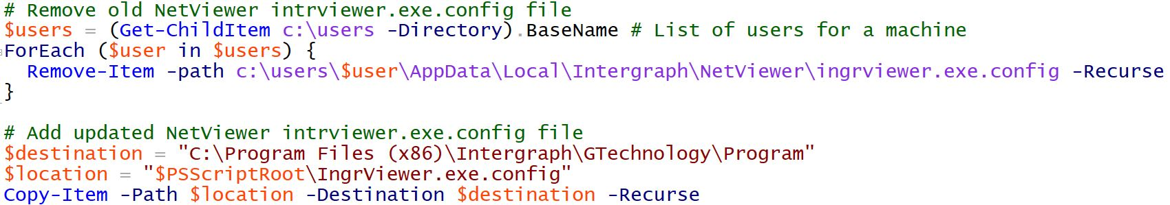
Daily Task: Software Update Script
Assigned Through Internal Ticketing System
Written in PowerShell
Deployed to Targeted PCs Through SCCM
Notes:
Explain what the two scripts do here: Updates Netviewer software by removing the old executable file and adding an updated one

Slide 5
Long-Term Task: Meltdown & Spectre BIOS Update
Problem Statement: Write a script to update the BIOS on ALL district computers
What is Meltdown & Spectre?
Flaws in the design of CPUs – present since 1995 and exposed in June 2017
Risks include:
Applications reading other application or kernel memory
Virtual Machines reading shared-host memory allocated to another VM
The Solution
Download and extract the most recent BIOS updates for all district HP machines
Write a script to install the BIOS update on all district computers

Slide 6
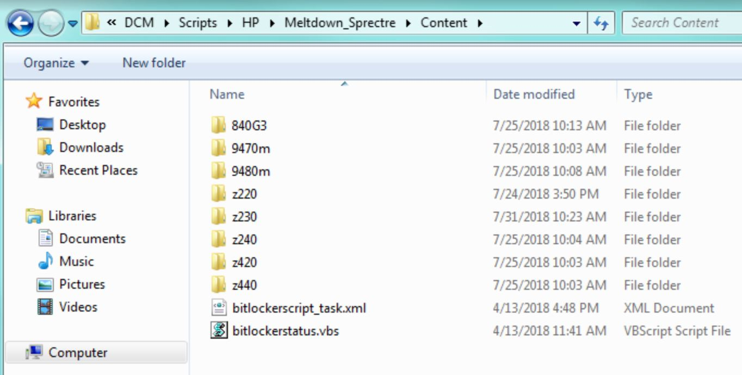
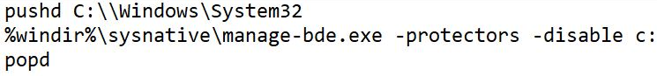
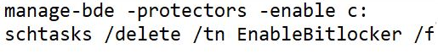
Meltdown & Spectre BIOS Update
Design
Download and extract all HP BIOS updates to root folder
Design helper cmd scripts that can disable and re-enable machines with encrypted drives using Bitlocker, which is Microsoft’s full volume encryption software
DisableBitlocker.cmd
EnableBitlocker.cmd

Slide 7
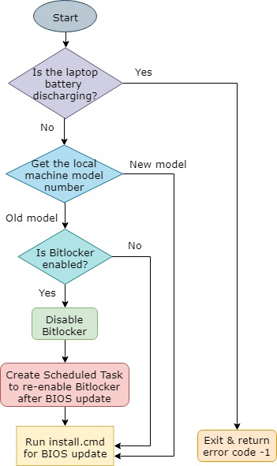
Logic Flow for BIOS Update Script
Meltdown & Spectre BIOS Update
Implementation
Write a complete BIOS update script for all HP models that accomplishes the logical flow of actions pictured here
Install.cmd – New models
pushd %~dp0\HPBIOSUPDREC
HPBIOSUPDREC.EXE -s -a -b -r
popd
Install.cmd – Old models
pushd %~dp0\hpqflash
hpqflash.exe -s -a
popd
Notes:
Run install.cmd. Newer models can use
pushd %~dp0\HPBIOSUPDREC
HPBIOSUPDREC.EXE -s -a -b -r
popd

Slide 8
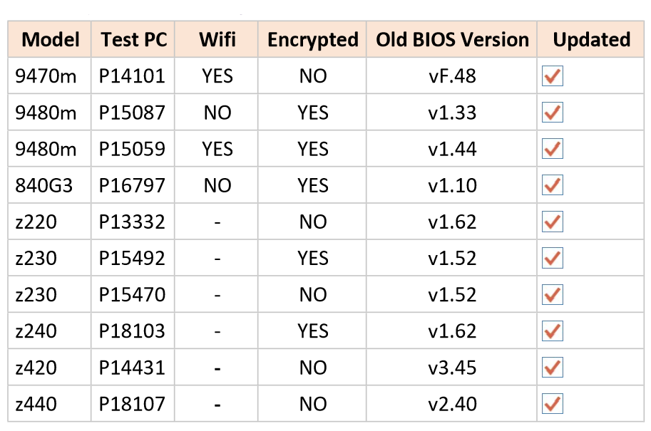
Meltdown & Spectre BIOS Update
Testing
Complete manual testing on isolated models, seen here

Slide 9
Meltdown & Spectre BIOS Update
Results
Deployed script through SCCM to a test group of 50 machines, which resulted in the success rates pictured here
Notes:
Failed = Laptops not connected to power adapter
In progress = User interference during scheduled update

Slide 10
Next Phase Meltdown & Spectre BIOS Update
With the script and testing completed, the ITS Infrastructure Support Team now must deploy the update to all district computers.
Organize departments into deployment groups (i.e. employee resources)
Notify all users within each deployment group of the scheduled date and time for the update
Schedule the deployment through SCCM
Deploy and monitor the update through SCCM
Review the deployment results
Failed & in progress – determine the source, then schedule re-deployment

Slide 11
Questions?
Special Thanks to Snohomish County PUD for this Internship!

